Slide 1
Weekly Progress
Maurice - Week 1

Slide 2
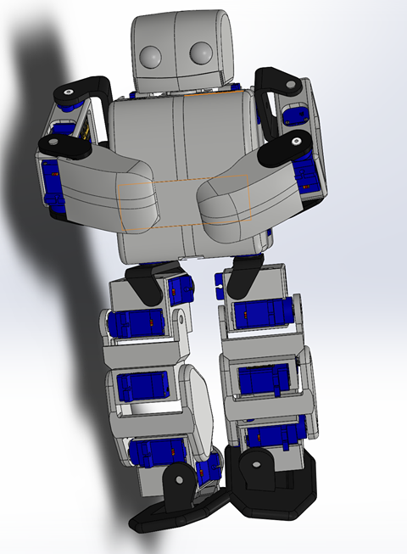
CAD Model - Fit FS90-FB servos
Modified existing SG90 CAD slightly to take up FS90-FB size (added 0.3mm height and 0.2mm width).
Then, took Fusion 360 files GrabCAD fit for SG90 (which someone else modified from PLEN2’s website) and fit new servos.
Servos for original CAD only available in Japan and give no feedback.
Completed all core purchases!

Slide 3
Tested Motors on Leg (3D Printed)
Most parts fit well, and the servos slot in snugly!

Slide 4
Needs work
Identified parts to modify further. Does not affect URDF (minor fit-related issues). ADVICE: Interface Servo with big holes...

Slide 5
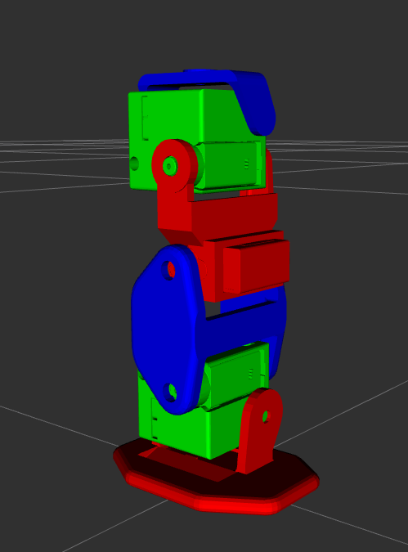
URDF Progress
Option 1: SolidWORKS plugin.
Option 2: Manual with STL mesh.
→ Explored 1 already without much success.
Going the manual route… one leg done
ADVICE: Moments of Inertia?

Slide 6
DDPG Research
Completed basics:
Explore-exploit dilemma → add Gaussian noise to DDPG action to explore
Markov Decision Process → state s’ only dependent on s.
Action-Value functions → eval policy based on Q(s,a) instead of V(s) reward.
Bellman equation → used as basis for TD Learning (similar but ++efficiency).
Temporal Difference Learning - used in DDPG to train Critic by min TD err.
Gradient Descent - used in DDPG to train Actor on output of Critic.
Q-Learning (basic) → Deep Q Learning → DDPG.

Slide 7
DDPG Fundamentals
Deep Q Learning basis
Target network treats instability of recursive loss function→ soft copy (trail) in DDPG instead of stale copy every few 000’ iterations.
Replay buffer to perform learning on temporally independent samples (draw randomly from batch to avoid drawing sequentially dependent (s, a, r, s’) tuples).
Epsilon-greedy policy, so don’t always use best action but always update over max(a’) using actor without knowing if a’ will actually be taken next. → Off-policy learning. (need to clarify).
Actor-Critic
Actor takes in state and output deterministic action a.
Critic takes state-action pair (action from current Actor) and outputs Q(s,a) value.
Critic trains faster than actor since actor performs gradient descent on critic value. So need good critic first.
Counter reward over-estimation bias using TD3
Alternate Actor and Critic training in each loop.
Use Target Actor in addition to Target Critic (four NNs in total!).

Slide 8
Research into PyBullet
Can take URDF just like Gazebo.
Has built-in environment and reward function interfaces.
Need to see whether digital servo motors can be modeled to make compatible with real robot (probably yes since I have seen many servo-based examples, just need to figure out how).
INERTIA TENSOR ASSEMBLY FROM SOLIDWORKS. MAKE SURE FRAMES MATCH WHAT IS IN XACRO! USE MODDED F3D FILES!
MAKE DRAWING OF DDPG DIAGRAM!

Slide 9
To do by next meeting:
Finish Pybullet or Gazebo model including servo motors.
Finish CAD including tolerance and start assembly.
More research (already know what papers to consult).

